Slide 1
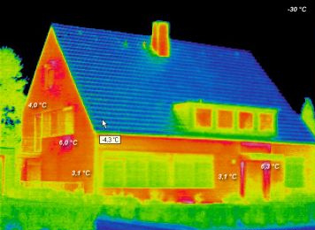
Temperature Sensors & Measurement
E80 Spring 2014

Slide 2
Contents
Why measure temperature?
Characteristics of interest
Types of temperature sensors
1. Thermistor
2. RTD Sensor
3. Thermocouple
4. Integrated Silicon Linear Sensor
Sensor Calibration
Signal Conditioning Circuits (throughout)

Slide 3
Why Measure Temperature?
Temperature measurements are one of the most common measurements...
Temperature corrections for other sensors
e.g., strain, pressure, force, flow, level, and position many times require temperature monitoring in order to insure accuracy.

Slide 4
Important Properties?
Sensitivity
Temperature range
Accuracy
Repeatability
Relationship between measured quantity and temperature
Linearity
Calibration
Response time

Slide 5
Types of Temperature Sensors?
Covered
Not Covered
1. Thermistor
Ceramic-based: oxides of manganese, cobalt , nickel and copper
2. Resistive Temperature Device -RTD
Metal-based : platinum, nickel or copper
3. Thermocouple
junction of two different metals
4. Integrated Silicon Linear Sensor
Si PN junction of a diode or bipolar transistor
5
5. Hot Wire Anemometer
6. Non-Contact IR Single Sensor
7. IR Camera

Slide 6
>$10

Slide 7
Part I Thermistor
High sensitivity
Inexpensive
Reasonably accurate
Lead resistance ignored
Glass bead, disk or chip thermistor
Typically Negative Temperature Coefficient (NTC),
PTC also possible
nonlinear relationship between R and T

Slide 8
Thermistor resistance vs temperature

Slide 9
Simple Exponential Thermistor Model
R_{T} = R₀ x exp[ β(1/T -1/T₀)]
R_{T} is the thermistor resistance (Ω).
T is the thermistor temperature (K)
Manufacturers will often give you R₀, T₀ and an average value for β
β is a curve fitting parameter and itself is temperature dependent.

Slide 10
Simple Exponential Thermistor Model
Usually T₀ is room temp 25ºC = 298ºK
So R₀ = R₂₅
R_{T} = R₂₅ x exp[β(1/T – 1/298)]
where β ≈ ln (R₈₅/R₂₅) /(1/358-1/298)
Not very accurate but easy to use

Slide 11
Better Thermistor model
Resistance vs temperature is non-linear but can be well characterised by a 3rd order polynomial
ln R_{T} = A + B / T +C / T² + D / T³
where A,B,C,D are the characteristics of the material used.

Slide 12
Inverting the equation
The four term Steinhart-Hart equation
T = [A₁ +B₁ ln(R_{T}/R₀)+C₁ ln²(R_{T}/R₀)+D₁ln³(R_{T}/R₀)]⁻¹
Also note:
Empirically derived polynomial fit
A, B, C & D are not the same as A₁, B₁ , C₁ & D₁
Manufacturers should give you both for when R₀ = R₂₅
C₁ is very small and sometime ignored (the three term SH eqn)

Slide 13
http://www.eng.hmc.edu/NewE80/PDFs/VIshayThermDataSheet.pdf

Slide 14
Thermistor Calibration
3-term Steinhart-Hart equation
T = [A₁ +B₁ ln(R_{T}/R₀)+D₁ln³(R_{T}/R₀)]⁻¹
How do we find A1, B1 and D1?
Minimum number of data points?
Linear regression/Least Squares Fit (Lecture 2)

Slide 15
Thermistor Problems: Self-heating
You need to pass a current through to measure the voltage and calculate resistance.
Power is consumed by the thermistor and manifests itself as heat inside the device
P = I² R_{T}
You need to know how much the temp increases due to self heating by P so you need to be given θ = the temperature rise for every watt of heat generated.

Slide 16
Heat flow
Very similar to Ohms law. The temperature difference (increase or decrease) is related to the power dissipated as heat and the thermal resistance.
Δ C = P x θ
P in Watts
θ in ºC /W

Slide 17
Self Heating Calculation
ΔºC = P x θ = (I² R_{T}) θ _{Device to ambient}
Example.
I = 5mA
R_{T} = 4kΩ
θ_{Device to ambient} = 15 ºC /W
ΔºC =
Notes:
1.5

Slide 18
Self Heating Calculation
ΔºC = P x θ = (I² R_{T}) θ _{Device to ambient}
Example.
I = 5mA
R_{T} = 4kΩ
θ_{Device to ambient} = 15 ºC /W
ΔºC = (0.005)² X 4000 X 15 = 1.5 C

Slide 19
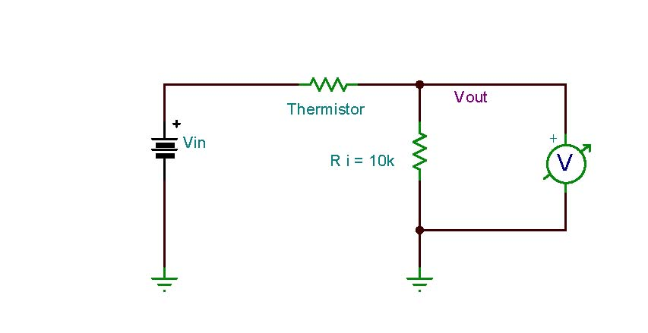
Linearization Techniques
Current through Thermistor is dominated by 10k Ω resistor.

Slide 20
Linearization of a 1O k-Ohm Thermistor
This plot Ti = 50 ⁰C, Ri = 275 Ω

Slide 21
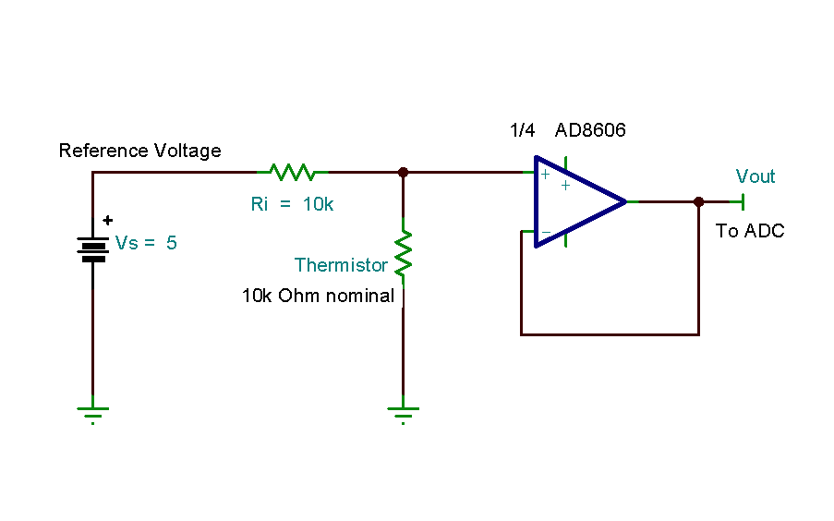
Linearization techniques

Slide 22
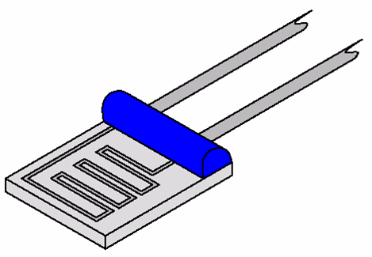
Part II RTD
Accurate & Stable
Reasonably wide temperature range
More Expensive
Positive temperature constant
Requires constant currant excitation
Smaller resistance range
Self heating is a concern
Lead wire resistance is a concern
More complicated
signal conditioning

Slide 23
pRTD, cRTD and nRTD
The most common is one made using platinum so we use the acronym pRTD
Copper and nickel as also used but not as stable

Slide 24
Linearity: The reason RTDs are so popular

Slide 25
RTD are almost linear
Resistance increases with temperature (+ slope)
R_{T} = R₀(1+ α)(T –T₀)
Recognized standards for industrial platinum RTDs are
IEC 6075 and ASTM E-1137 α = 0.00385 Ω/Ω/°C

Slide 26
Measuring the resistance needs a constant current source
Read AN 687 for more details (e.g. current excitation circuit):
http://ww1.microchip.com/downloads/en/AppNotes/00687c.pdf
http://www.control.com/thread/1236021381
on 3-wire RTD

Slide 27
With long wires precision is a problem
Two wire circuits,
Three wire circuits and
Four wire circuits.

Slide 28
Two wire: lead resistances are a problem
Power supply connected here
No current flows in here
The IDAC block is a constant current sink

Slide 29
Three wire with two current sinks

Slide 30
Four wire with one current sink.

Slide 31
4 wire with precision current source

Slide 32
Mathematical Modelling the RTD
The Callendar-Van Dusen equation
R_{T} = R₀ (1 + A T + B T² + C T³(T-100) for T < 0 ºC
= R₀ (1+ A T + B T²) for T > 0 ºC
where R₀ is the resistance at T₀ = 0 ºC and
For platinum
A = 3.9083 x e-3 ºC⁻¹
B = -5.775 x e-7 ºC⁻²
C = -4.183 x e-12 ºC⁻⁴

Slide 33
Experimentally
Derive temperature (+/-) from the measured resistance.
Easiest way is to construct a Look-Up table inside LabView or your uP
Precision, accuracy, errors and uncertainties need to be considered.

Slide 34
Experimental uncertainties
For real precision, each sensor needs to be calibrated at more than one temperature and any modelling parameters refined by regression using a least mean squares algorithm.
LabView, MATLAB and Excel have these functions
The 0ºC ice bath and the ~100 ºC boiling de-ionised water (at sea level) are the two most convenient standard temperatures.

Slide 35
Part III Thermocouples
High temperature range
Inexpensive
Withstand tough environments
Multiple types with different temperature ranges
Requires a reference temperature junction
Fast response
Output signal is usually small
Amplification, noise filtration and signal processing required

Slide 36
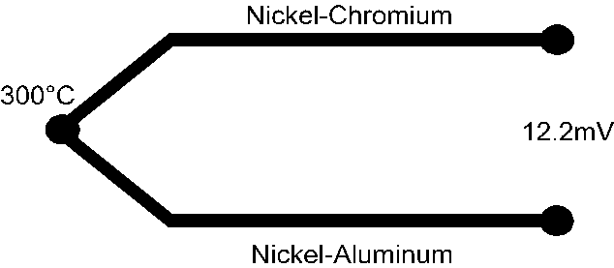
Seebeck Effect
Type K thermocouple

Slide 37
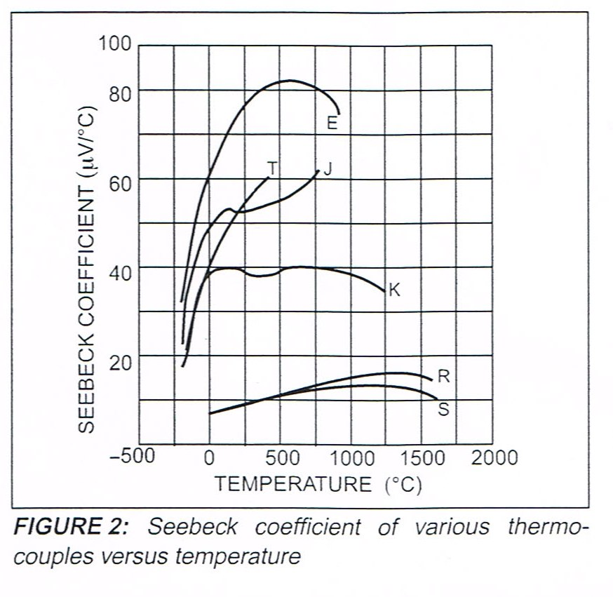
Thermocouples are very non-linear

Slide 38
Mathematical Model
To cover all types of thermocouples, we need a 6 - 10th order polynomial to describe the relationship between the voltage and the temperature difference between the two junctions
Either
T = a₀ +a₁ x V + a₂ x V² +++++ a₁₀ V¹⁰
Or
V = b₀ +b₁ x T + b₂ x T² +++++ b₁₀ T¹⁰
+ αo exp(α1(T-126.9686)²) for T >0ºC

Slide 39
10th order polynomial fit: Find T from measured Voltage

Slide 40
What happens when we connect a meter?

Slide 41
What happens when we connect a meter?
Cu
Cu

Slide 42
Cold Junction Compensation

Slide 43
Can we read the voltage directly from our DAQ or meter?

Slide 44
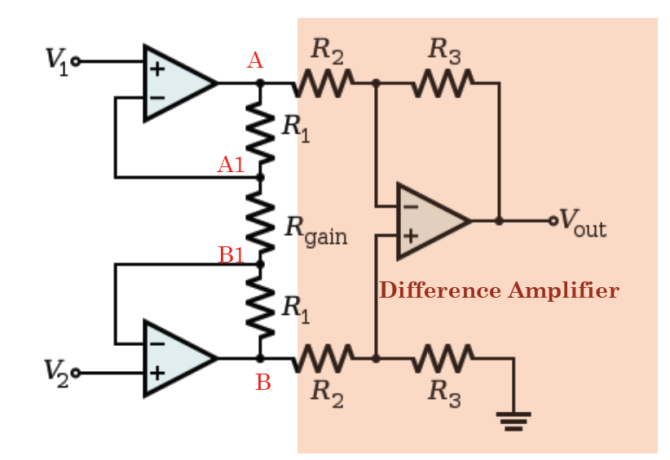
Instrumentation Amplifier

Slide 45
One more thing…
Low voltage signal…
Long leads…
What problems could arise?

Slide 46
Thermocouple with compensation and filtering

Slide 47
Look-up table is easier than using a polynomial

Slide 48
What does 8 bit accuracy mean?
Eight bits = 2⁸-1 levels = 255 levels
Assume supply voltage between 0 and 5 volts
Minimum V step between each level ≈ 20mV
Temp range say 0 to 400 ºC
Minimum temperature step ≈ 1.6 ºC
This determines the quantisation error regardless the accuracy of the sensor
i.e., Temp = T +/- 0.8ºC

Slide 49
Part IV Silicon Detectors
Integrated form
-40°C to +150°C
Limited accuracy +/- 2 degree
Linear response ( no calibration is required)
Direct interface with ADC

Slide 50
References
Previous years’ E80
Wikipedia
Microchip Application Notes AN679, AN684, AN685, AN687
Texas Instruments SBAA180
Omega Engineering www.omega.com (sensor specs, application guides, selection guides, costs)
Baker, Bonnie, “Designing with temperature sensors, part one: sensor types,” EDN, Sept 22, 2011, pg 22.
Baker, Bonnie, “Designing with temperature sensors, part two: thermistors,” EDN, Oct 20, 2011, pg 24.
Baker, Bonnie, “Designing with temperature sensors, part three: RTDs,” EDN, Nov 17, 2011, pg 24.
Baker, Bonnie, “Designing with temperature sensors, part four: thermocouples,” EDN, Dec 15, 2011, pg 24.

Slide 51
Baker, Bonnie, “Designing with temperature sensors, part one: sensor types,” EDN, Sept 22, 2011, pg 22.
Baker, Bonnie, “Designing with temperature sensors, part two: thermistors,” EDN, Oct 20, 2011, pg 24.
Baker, Bonnie, “Designing with temperature sensors, part three: RTDs,” EDN, Nov 17, 2011, pg 24.
Baker, Bonnie, “Designing with temperature sensors, part four: thermocouples,” EDN, Dec 15, 2011, pg 24.

